Slide 1
Eliminating Read Barriers through Procrastination and Cleanliness
KC Sivaramakrishnan
Lukasz Ziarek
Suresh Jagannathan

Slide 2
Big Picture
Lightweight user-level threads
Scheduler 1
Lots of concurrency!
t1
t2
tn
Core 1
Core 2
Core n
Heap

Slide 3
Big Picture
Big Picture
Expendable resource?
Scheduler 1
Lots of concurrency!
t1
t2
tn
Heap
3

Slide 4
Big Picture
Big Picture
Exploit program concurrency
to
eliminate read barriers from thread-local collectors
Expendable resource?
Scheduler 1
Lots of concurrency!
t2
tn
t1
Alleviate MM cost?
Heap
GC Operation
4

Slide 5
MultiMLton
Goals
Safety, Scalability, ready for future manycore processors
Parallel extension of MLton – a whole-program, optimizing SML compiler
Parallel extension of Concurrent ML
Lots of Concurrency!
Interact by sending messages over first-class channels
send (c, v)
C
v ← recv (c)
Notes:
* sharing mutable objects

Slide 6
MultiMLton GC: Considerations
Standard ML – functional PL with side-effects
Most objects are small and ephemeral
Independent generational GC
# Mutations << # Reads
Keep cost of reads to be low
Minimize NUMA effects
Run on non-cache coherent HW

Slide 7
MultiMLton GC: Design
Thread-local GC
Shared Heap
Local Heap
Local Heap
Local Heap
Local Heap
Core
Core
Core
Core
NUMA Awareness
Circumvent cache-coherence issues

Slide 8
Invariant Preservation
Read and write barriers for preserving invariants
Transitive closure of x
Exporting writes
Shared Heap
Shared Heap
Target
r
r
x
r := x
Local Heap
Local Heap
Source
x
Mutator needs read barriers!
FWD

Slide 9
Challenge
Object reads are pervasive
RB overhead ∝ cost (RB) * frequency (RB)
Read barrier optimization
Stacks and Registers never point to forwarded objects
Mean Overhead
----------------------
Read barrier overhead (%)
20.1 %
15.3 %
21.3 %
Notes:
----- Meeting Notes (6/10/12 12:18) -----
* add one more point

Slide 10

Mutator and Forwarded Objects
# Encountered forwarded objects
<
0.00001
# RB invocations
Eliminate read barriers altogether

Slide 11
RB Elimination
Visibility Invariant
Mutator does not encounter forwarded objects
Observation
No forwarded objects created ⇒ visibility invariant ⇒ No read barriers
Exploit concurrency → Procrastination!

Slide 12
Procrastination
T1
T2
Shared Heap
r1
r2
→ r1 := x1
r2 := x2
Local Heap
x1
x2
T
→ T is running
T
→ T is suspended
T
→ T is blocked

Slide 13
Procrastination
T1
T2
Shared Heap
r1
r2
r1 := x1
→ r2 := x2
Control switches to T2
Local Heap
x1
x2
T
→ T is running
T
Delayed write list →
→ T is suspended
T
→ T is blocked

Slide 14
Procrastination
T1
T2
Shared Heap
r1
r2
r1 := x1
r2 := x2
Local Heap
x1
x2
T
→ T is running
T
Delayed write list →
→ T is suspended
T
→ T is blocked

Slide 15
Procrastination
T1
T2
Shared Heap
r1
x1
r2
x2
r1 := x1
r2 := x2
Local Heap
FWD
FWD
T
→ T is running
T
Delayed write list →
→ T is suspended
T
→ T is blocked

Slide 16
Procrastination
T1
T2
Shared Heap
r1
x1
r2
x2
→ r1 := x1
r2 := x2
Local Heap
Force local GC
T
→ T is running
T
Delayed write list →
→ T is suspended
T
→ T is blocked

Slide 17

Correctness
Does Procrastination introduce deadlocks?
Threads can be procrastinated while holding a lock!
T
→ T is running
T1
T2
T2
T
→ T is suspended
T
→ T is blocked

Slide 18
Correctness
Does Procrastination introduce deadlocks?
Threads can be procrastinated while holding a lock!
T
→ T is running
T1
T2
T
→ T is suspended
T
→ T is blocked
Is Procrastination safe?
Yes. Forcing a local GC unblocks the threads.
No deadlocks or livelocks!

Slide 19
Correctness
Does Procrastination introduce deadlocks?
Threads can be procrastinated while holding a lock!
T
→ T is running
T1
T2
T
→ T is suspended
T
→ T is blocked
Is Procrastination safe?
Yes. Forcing a local GC unblocks the threads.
No deadlocks or livelocks!
Notes:
Livelocks

Slide 20
Is Procrastination alone enough?
Efficacy (Procrastination) ∝ # Available runnable threads
M
Serial (low thread availability)
F
W₁
W₁
W₁
Concurrent (high thread availability)
J
With Procrastination, half of local major GCs were forced
Eager exporting writes while preserving visibility invariant

Slide 21

Cleanliness
A clean object closure can be lifted to the shared heap without breaking the visibility invariant
r := x
inSharedHeap (r)
inLocalHeap (x)
&&
isClean (x)
Eager write (no Procrastination)

Slide 22
Cleanliness: Intuition
Shared Heap
lift (x) to shared
heap
Local Heap
x

Slide 23
Cleanliness: Intuition
Shared Heap
x
find all references
to FWD
Local Heap
FWD

Slide 24
Cleanliness: Intuition
Shared Heap
x
Need to scan the
entire local heap
Local Heap

Slide 25
Cleanliness: Simpler question
Shared Heap
x
Do all references
originate from
heap region h?
Local Heap
h
FWD
sizeof (h) << sizeof (local heap)

Slide 26
Cleanliness: Simpler question
Shared Heap
x
Only scan the
heap region h.
Heap session!
Local Heap
h
sizeof (h) << sizeof (local heap)

Slide 27
Heap Sessions
Source of an exporting write is often
Young
rarely referenced from outside the closure
Young Objects
Local Heap
Previous Session
Current Session
Free
Old
Objects
Start
SessionStart
Frontier
Current session closed & new session opened
After an exporting write, a user-level context switch, a local GC

Slide 28
Heap Sessions
Source of an exporting write is often
Young
rarely referenced from outside the closure
Local Heap
Previous Session
Free
Start
Frontier & SessionStart
Current session closed & new session opened
After an exporting write, a user-level context switch, a local GC
SessionStart is moved to Frontier
Average current session size < 4KB

Slide 29
Cleanliness: Eager exporting writes
A clean object closure
is fully contained within the current session
has no references from previous session
Previous Session
Current Session
Free
X
Local Heap
Y
Z
r := x
r
Shared Heap

Slide 30
Cleanliness: Eager exporting writes
A clean object closure
is fully contained within the current session
has no references from previous session
Walk and fix
Previous Session
Current Session
Free
Local Heap
FWD
r := x
r
X
Shared Heap
Y
Z

Slide 31
Avoid tracing current session?
Many SML objects are tree-structured (List, Tree, etc,.)
Specialize for no pointers from outside the object closure
∀x’ ∊ transitive object closure (x),
ref_count (x) = 0 && ref_count (x’) = 1
Local Heap
x(0)
z(1)
No refs from outside
y(1)
ref_count does not consider pointers from stack or registers
Eager exporting write
No current session tracing needed!
Notes:
----- Meeting Notes (6/10/12 12:18) -----
* Animation for the slide

Slide 32
Reference Count
Purpose
Track pointers from previous session to current session
Identify tree-structured object
Current Session
Current Session
Current Session
PrevSess
Current Session
X(0)
X(1)
X(LM)
X(G)
Zero
One
LocalMany
Global
Does not track pointers from stack and registers
Reference count only triggered during object initialization and mutation
Notes:
* Remove the state transition diagram??

Slide 33
Bringing it all together
∀x’ ∊ transitive object closure (x),
if max (ref_count (x’))
One & ref_count (x) = 0 ⇒ tree-structured (Clean) ⇒ Session tracing not needed
LocalMany ⇒ Clean ⇒ Trace current session
Global ⇒ 1+ pointer from previous session ⇒ Procrastinate

Slide 34
Example 1: Tree-structured Object
Previous Session
Current Session
T1
x(0)
z(1)
current
stack
Local Heap
y(1)
r := x
Shared heap
r

Slide 35
Example 1: Tree-structured Object
Walk current stack
Previous Session
Current Session
T1
current
stack
FWD
Local Heap
r := x
Shared heap
r
x
z
y

Slide 36
Example 1: Tree-structured Object
Previous Session
Current Session
T1
current
stack
Local Heap
r := x
No need to walk current session!
Shared heap
r
x
z
y

Slide 37
Example 1: Tree-structured Object
Previous Session
Current Session
T1
T2
current
stack
FWD
Next
stack
Local Heap
r := x
Shared heap
r
x
z
y

Slide 38
Example 1: Tree-structured Object
Previous Session
Current Session
T1
T2
Context Switch
previous
stack
current
stack
Local Heap
r := x
Walk target stack
Shared heap
r
x
z
y

Slide 39
Example 2: Object Graph
Previous Session
Current Session
z(1)
a
x(0)
current
stack
Local Heap
y(LM)
r := x
Shared heap
r

Slide 40
Example 2: Object Graph
Walk current stack
Previous Session
Current Session
FWD
a
current
stack
Local Heap
FWD
r := x
Walk current session
Shared heap
z
r
x
y

Slide 41
Example 2: Object Graph
Walk current stack
Previous Session
Current Session
a
current
stack
Local Heap
r := x
Walk current session
Shared heap
z
r
x
y
Notes:
----- Meeting Notes (6/10/12 12:18) -----
Walk current session

Slide 42
Example 3: Global Reference
Previous Session
Current Session
a
z(G)
x(0)
T1
current
stack
Local Heap
y(1)
r := x
Shared heap
r

Slide 43
Example 3: Global Reference
Previous Session
Current Session
a
z(G)
x(0)
T1
current
stack
Local Heap
y(1)
r := x
Procrastinate
Shared heap
r

Slide 44
Immutable Objects
Specialize exporting writes
If immutable object in previous session
Copy to shared heap
Immutable objects in SML do not have identity
Original object unmodified
Avoid space leaks
Treat large immutable objects as mutable

Slide 45
Cleanliness: Summary
Cleanliness allows eager exporting writes while preserving visibility invariant
With Procrastination + Cleanliness, <1% of local GCs were forced

Slide 46
Evaluation
Variants
RB- : TLC with Procrastination and Cleanliness
RB+ : TLC with read barriers
Sansom’s dual-mode GC
Cheney’s 2-space copying collection ←→ Jonker’s sliding mark-compacting
Generational, 2 generations, No aging
Target Architectures:
16-core AMD Opteron server (NUMA)
48-core Intel SCC (non-cache coherent)
864-core Azul Vega3
Notes:
Split into program characteristics separately

Slide 47
Results
Speedup: At 3X min heap size, RB- faster than RB+
AMD (16-cores) 32% (2X faster than STW collector)
SCC (48-cores) 20%
AZUL (864-cores) 30%
Concurrency
During exporting write, 8 runnable user-level threads/core!
Notes:
* Benchmark Char

Slide 48
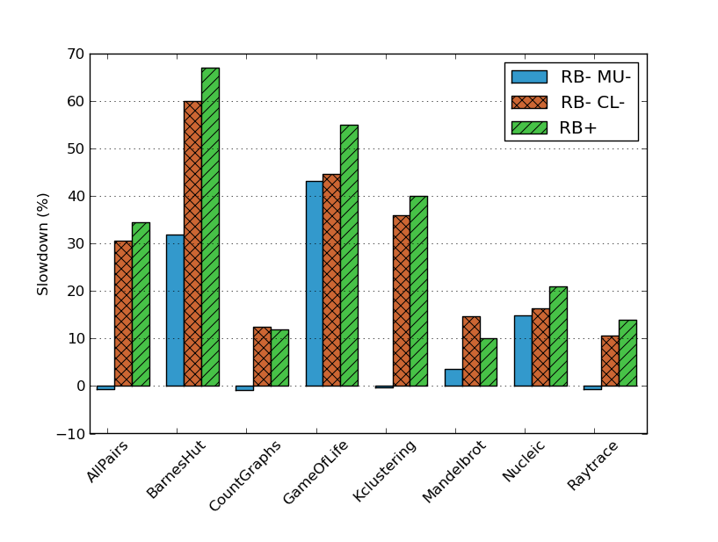
Cleanliness Impact
RB- MU- : RB- GC ignoring mutability for Cleanliness
RB- CL- : RB- GC ignoring Cleanliness (Only Procrastination)
Avg. slowdown
--------------------
11.4%
28.2%
31.7%
48
Notes:
Add RB+ Numbers..

Slide 49
Conclusion
Eliminate the need for read barriers by preserving the visibility invariant
Procrastination: Exploit concurrency for delaying exporting writes
Cleanliness: Exploit generational property for eagerly perform exporting writes
Additional niceties
Completely dynamic → Portable
Does not impose any restriction on the GC strategy

Slide 50

Questions?
http://multimlton.cs.purdue.edu

Slide 51
Results
On AMD, 16 Cores, 3X minimum heap size
Mutator time:
STW GC spends the least amount of time in the mutator
No read/write barriers
Compared to STW GC, the mutator time of
RB- 18% more, RB+ 39% more
GC time:
RB- spends the least amount time doing GC
RB- within 5% of RB+
Notes:
* Benchmark Char

Slide 52
Performance on AMD (16-cores)
At 3X min heap size:
-------------------
RB+ 32%
STW 106%
BDW 584%
Notes:
Summary only for RB-
Provide speedups on different architectures
Mutator time approaches STW
GC time approaches RB+

Slide 53
MultiMLton - SCC implementation
Non-Cached -- Shared heap
Cached -- Local heap
Notes:
* Delete

Slide 54
Total time: SCC and AZUL
SCC (48-cores)
AZUL (864-Cores)
20%
30%
Non-cache coherent
Scalable, cache-coherent
Notes:
* No need…

Slide 55
Cleanliness Impact (1)
Number of Preemptions on exporting writes
Forced GCs as a % of total number of local major GCs

Slide 56
Benchmark Characteristics

Slide 57
Session Impact

Slide 58
Read Barrier
Conditional (Baker Style)
Unconditional (Brooks style)
From
From
To
To
Notes:
> 90 % of objects are less than 4 words in length

Slide 59
Read Barrier
Conditional (Baker Style)
Unconditional (Brooks style)
From
From
F
F
To
To
pointer readBarrier (pointer *p) {
if (*(Header*)(p – HD_OFF) == F)
return *(pointer*)p;
return p;
}
pointer readBarrier (pointer *p) {
return *(pointer*)(p – IND_OFF);
}
Has Conditional Check
Needs extra header word
Notes:
> 90 % of objects are less than 4 words in length

Slide 60
Read Barrier Optimizations
Stacks and registers never point to forwarding pointers
“Eager” read barriers (D.Bacon et al. POPL’93)
Scan stack after exporting write
Exporting write is a GC safe-point
Reduces RB overhead by ~5%

Slide 61
Performance on AZUL
At 3X min heap size:
--------------
RB+ 30%

Slide 62
Performance on SCC
At 3X min heap size:
--------------
RB+ 20%
Notes:
Increase in GC is steeper on the SCC as we decrease the heap size due to high shared heap GC cost
We also tend to do lots of shared heap collections since the shared heap space is small (64MB)

Slide 63
Under the hood
T1
T2
send (c, v)
C
v ← recv (c)
Abstract Shared Heap
T1’s local heap
T2’s local heap
v
C
Before Communication
Notes:
* sharing mutable objects

Slide 64
Under the hood
T1
T2
send (c, v)
C
v ← recv (c)
Abstract Shared Heap
v
T1’s local heap
T2’s local heap
C
After Communication
Notes:
* sharing mutable objects

